Slide 1
CS4770 Lecture 4 – Attack Surfaces
By Chad Mourning
Heavily Influenced by the Textbook

Slide 2
Attack Surfaces
Vulnerabilities must be:
Reachable
Exploitable
Examples:
Services listening on open ports
Interfaces to services such as web forms
Poorly written code
People

Slide 3
Taxonomy of Attack Surfaces
Network attack surface: This category refers to vulnerabilities over an enterprise network, wide-area network, or the Internet. Included in this category are network protocol vulnerabilities, such as those used for a denial-of-service attack, disruption of communications links, and various forms of intruder attacks.
Software attack surface: This refers to vulnerabilities in application, utility, or operating system code. A particular focus in this category is Web server software.
Human attack surface: This category refers to vulnerabilities created by personnel or outsiders, such as social engineering, human error, and trusted insiders.

Slide 4
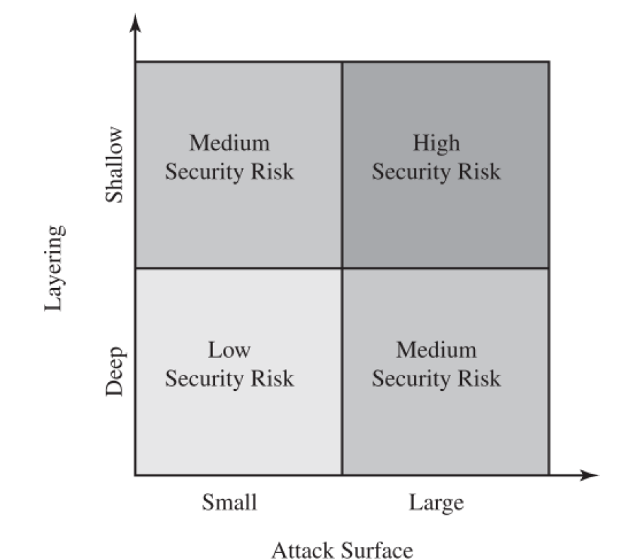
Risk Factors
I think this picture would be better if:
The dimensions would clearly spectral.
There’s more than 2 possible states.
You could find a way to make the shallow arrow go the other way.
Risk increases with the size of the attack surface.
Risk decreases with the depth of layering.

Slide 5
Attack Trees
A way to express “branching” of attack surfaces
Once you are “in” another system, you may need a way to escalate privilege or access specific targets.
There may be multiple things you can do, once you’re in.

Slide 6
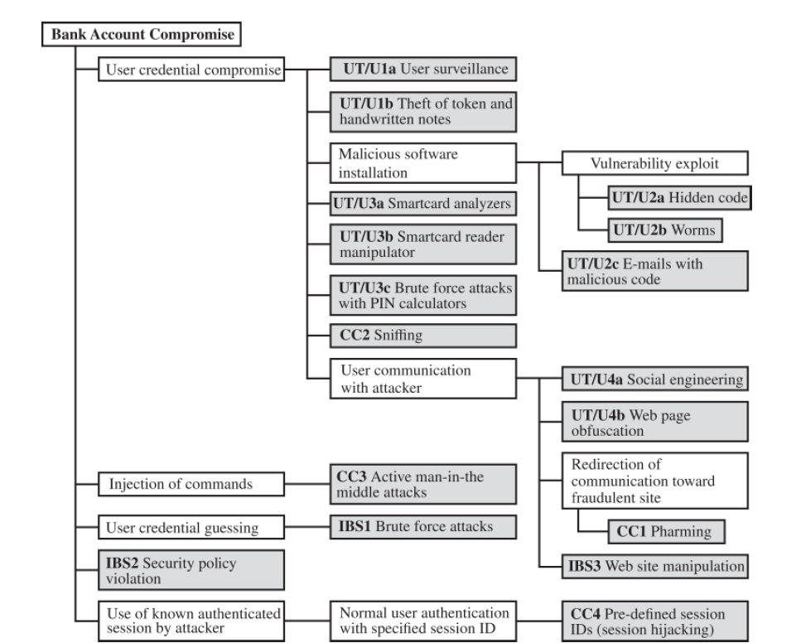
Attack Tree Example
A combination of:
Physical Security
Network Security
Poor Implementations

